Slide 1

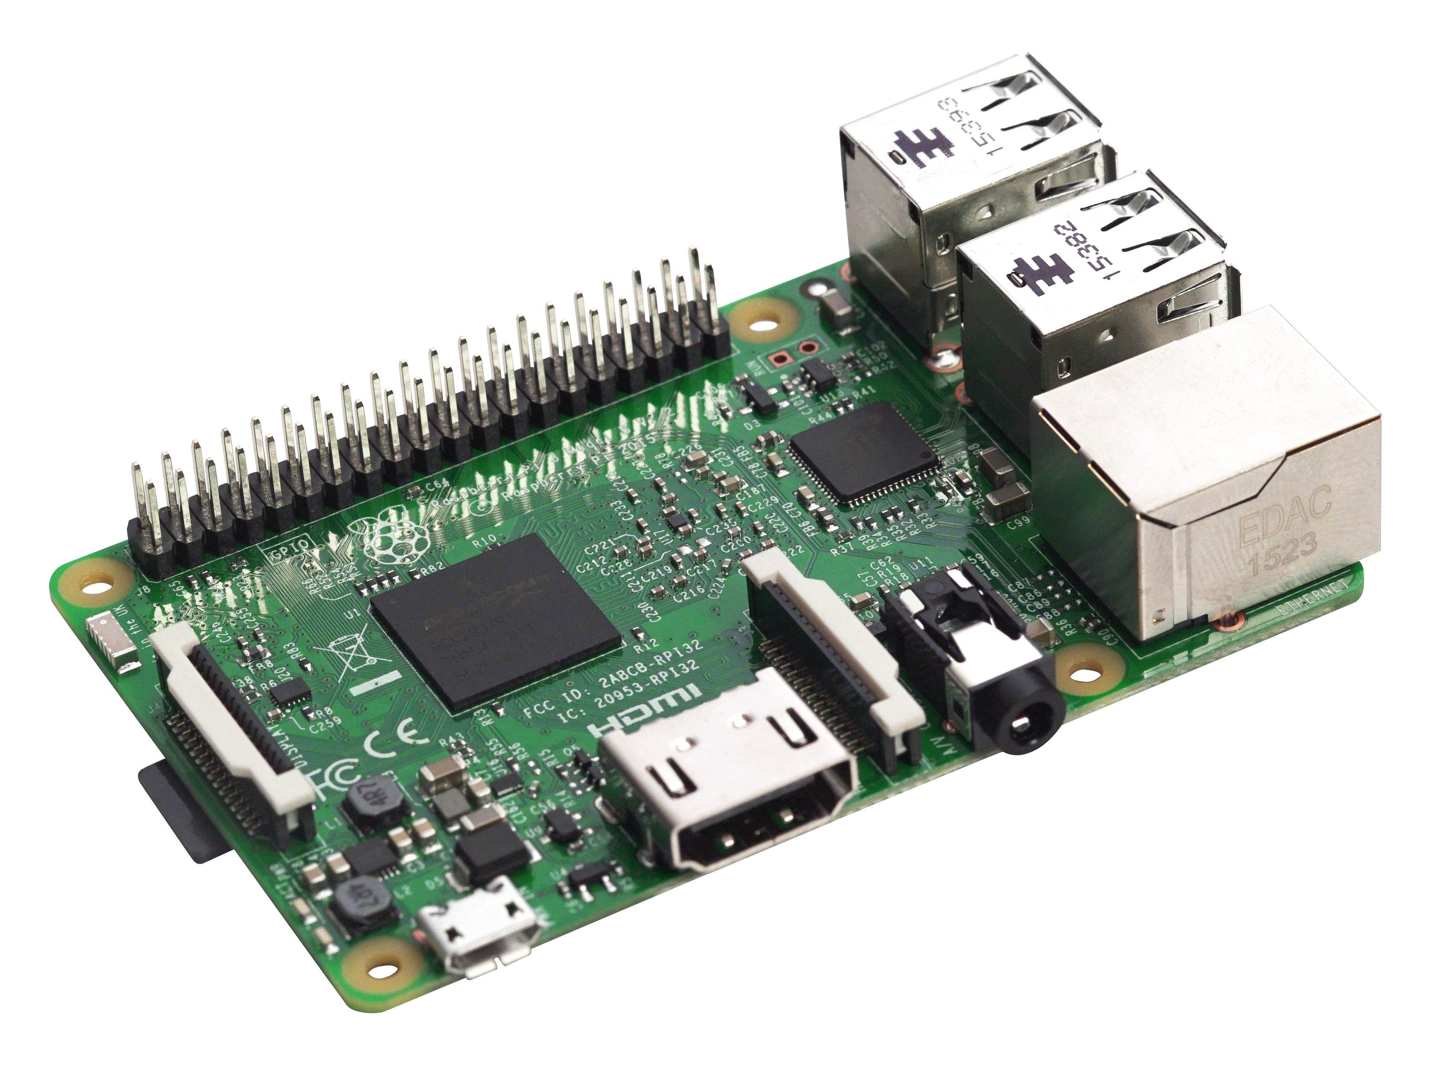

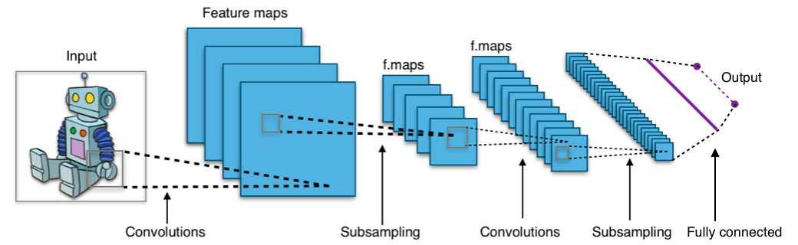
Scalable Gunshot Detection Systems with Convolutional Neural Networks
Alex Morehead¹, Lauren Ogden², Gabe Magee³, Ryan Hosler⁴, Dr. George Mohler⁴
¹Department of Computer Science, Mathematics, & Physics, Missouri Western State University; ²Department of Computer Science, Columbia University;
³Department of Computer Science, Pomona College; ⁴Department of Computer and Information Science, IUPUI School of Science
Introduction
Methodology
Process and Issues
Many cities with gunshot detection systems depend
on expensive systems that rely on humans differentiating between
gunshots and non-gunshots, such as ShotSpotter®. Thus, a
scalable gunshot detection system that is low in cost and high
in accuracy would be advantageous for a variety of cities across
the globe, in that it would favorably promote the delegation of
tasks typically worked by humans to machines.
Training
A convolutional neural network (CNN) was trained on a variety of sound data to recognize gunshots. While we had labels for sounds other than gunshots, we grouped them into a singular group “other”. Then each of these samples were preprocessed to turn them into spectrograms if the model was trained on them. The models were trained for 100 epochs or until the target metric of a training session, accuracy in this case, did not change for fifteen epochs.
The Data
We obtained out data from two places – free internet databases such as Freesound and sounds recorded on a Raspberry Pi microcomputer. In addition to this, we used a generative adversarial network (GAN) as well as augmentations to create additional samples of gunfire sounds and to prevent our model from overfitting to our compiled dataset.
Deployment
Each model was then deployed to a Raspberry Pi Model 3 B+ with an SMS modem attached. In order to conserve space, we decided to convert them to TensorFlow Lite (TFLite) models, with a tradeoff for performance time. Our program has three processes – one to put audio from a stream onto a queue, one to analyze sound data pulled from the queue, and one to send an SMS alert message to a predetermined list of phone numbers.
Time Shift | Pitch Change | Speed Change | Volume Change | Background Noise Addition
Shifts a sound sample to the left or right by a randomly chosen amount less than 50% of the length, and then fills in silence as needed. | Changes the pitch of a sample by a randomly-chosen factor between 70% and 130%. | Alters the playback speed of a sample by a randomly-chosen amount between 70% and 130%. | Increases the amplitude of a sample with a uniformly-random variable. | Introduces random background noise into a sample while making sure that no gunshots are added into a sample that does not originally contain a gunshot.
CNNs
Performance
Convolutional Neural Networks (CNNs) are neural networks designed to locate, model, and accurately predict patterns present in input data such as a colored image.
The findings generated by this research project have the potential to expand the current state of knowledge regarding sound-based applications of CNNs, and while simultaneously reducing the amount of jobs that require human input, the results of this project could very well increase the standards of safety for a city’s residents.
They do so by iteratively sliding over small regions of data and translating any inherent properties in a region over to a proceeding network layer. This process is repeated up until the output layer which generates a prediction.
Gunshot Detection Results
Using a validation data set, we found that {insert findings here}.
Spectrograms
 | 1D Convolutional Neural Network |  | 2D Convolutional Neural Network |  | 1D + 2D Convolutional Neural Network Ensemble
 | Keras | TFLite | Keras | TFLite | Keras | TFLite
Precision
Accuracy
Recall
Spectrograms are visual representations of the frequency and magnitude of sound over a specified span of time. For our project, we created two models that analyzed sound represented as a spectrogram. For one model, the value at each specific cartesian coordinate is a single value, while with another model, the information is denser – a tuple is contained at each coordinate.
Acknowledgements
We gratefully acknowledge the support of NSF grant REU-1659488 which provided this project’s research stipends, travel funds, and supply money.

